Slide 1
CS 2212B
Introduction to Software Engineering
Kostas Kontogiannis
Lecture 3: Requirements Engineering (Chapter 4)

Slide 2
What we will cover
Requirements Specification Techniques
Classic Technique
Object Oriented Technique ←
Use Case Diagrams
Sequence Diagrams
Collaboration Diagrams

Slide 3
Different Types of Models
Functional Model
Denotes and describes the system functions and operations for the view of its users
We employ Use Case diagrams, and Use Case Descriptions
Object Model
Denotes and describes the static structure of the system as a collection of classes, objects, entities, and relationships between them
We employ Class Diagrams, Component Diagrams, and Deployment Diagrams
Dynamic Model
Denotes and describes the internal operation of the system
We employ Sequence Diagrams, Activity Diagrams, State Diagrams and Communication Diagrams

Slide 4
Modeling with UML
Requirements Modeling | Scenarios, Use Case Diagrams
Static Modeling | Class Diagrams Object Diagrams Component Diagrams Deployment Diagrams
Dynamic Modeling | Sequence Diagrams Collaboration Diagrams – Communication Diagrams στη UML 2.0
Modeling the behavior of specific objects/classes | State Diagrams
Modeling the execution of system process steps | Activity Diagrams
Modeling system
operation – user’s
view
System
Structure
Modeling
System
Behavior Modeling

Slide 5
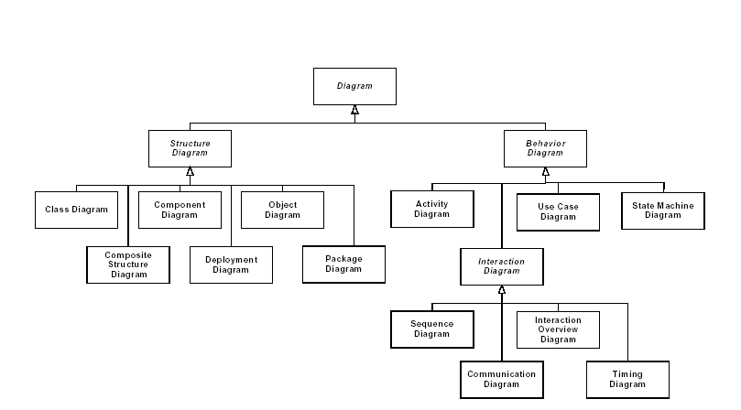
UML 2.0 Diagrams Structure

Slide 6
UML Diagrams
Structural diagrams
Static structural diagrams
Class diagrams
Object diagrams
Implementation diagrams
Component diagrams
Deployment diagrams
Behavior diagrams
Use case diagrams
Interaction diagrams
Sequence diagrams
Communication - Collaboration diagrams
State diagrams
Activity diagrams

Slide 7
Use Case Diagrams
A Use Case diagram is composed of operations of the specific use case being modeled, the participating actors in the use case being modeled, and relationships between these actors and these operations
In order to compose a Use Case diagram we chose only the operations which are visible from the perspective of external system or agent
Use Case diagrams can be applied for:
Modeling system context
Which agents interact with which operations (in the use case being modeled)
Modeling the functional requirements of the specific Use Case
Which are the operations which are relevant to the specific Use Case

Slide 8
Relationship of Use Case Models with other UML Models
Use Case Model
Is achieved by
Is verified by
Is implemented by
Design Model
Implementation Model
Test Model

Slide 9
Structural Elements of Use Case Diagrams (1)

Slide 10
Structural Elements of Use Case Diagrams (2)
<<extend>>

Slide 11
Structural Elements of Use Case Diagrams (3)
<<include>>

Slide 12
Use Case Diagram Example
An entity can play the
role of one or more
agents at the same
time
Billing
System

Slide 13
Use Case Diagram Example

Slide 14
Use Case Diagram Example

Slide 15
<<include>>, <<extend>> Stereoptypes
<<extend>>
(set priority)
Place order
Extension points
set priority
Place
rush order
<<include>>
Check
password
Track order
<<include>>
Validate user
Retinal scan

Slide 16
Use Case Model = Use Case Diagrams + Use Case Descriptions
Use Case Model
Mnemonic name for the use case
Use case outline
Events/steps for the use case
Pre-conditions
Post-conditions
Use Case Descriptions (structured text)
Use case diagrams
Other special requirements
Actors
Use Case / Operation
...
Use Case Descriptions

Slide 17
Flow of Events in a Use Case Description
The normal execution path (everything goes well) (“Happy Path”)
One or more alternative paths
Normal cases
Odd or cases
Extreme cases
Pathological cases
“Happy Path”

Slide 18
Steps for Requirements Modeling
Elicit scenarios from users
Factor scenarios with common behaviour in new unified use cases
Define the actors playing a role or interacting in a use case
Define the behavior of every actor
Define basic system operations for a use case
Compile use case descriptions (as structured text - use case steps - see flight time change use case example in Lesson 2)
Compile a use case diagram

Slide 19
Tips for Use Case Models
Scenarios (and use cases) are defined in natural language text that contains verbs and nouns. Nouns will help us determine the entities that appea rin the scenario and hence help us define the domain model (i.e. classes and their associations). Verbs will help us determine the operations in the scenario.
Factored scenarios (i.e. related scenarios form a use case)
A Use Case describes an important and fully understood system function from the perspective of the users (and the programmers)
Identification of stereotypes <<include>> and <<extend>>
If an operation is required for the completion of another operation we use <<include>>
If an operation denotes an alternative and optional way of completing another operation we use <<extend>>
A Use Case Diagram
Contains operations at the same level of abstraction
Contains only the necessary actors
Many related use cases can be combined in packages

Slide 20
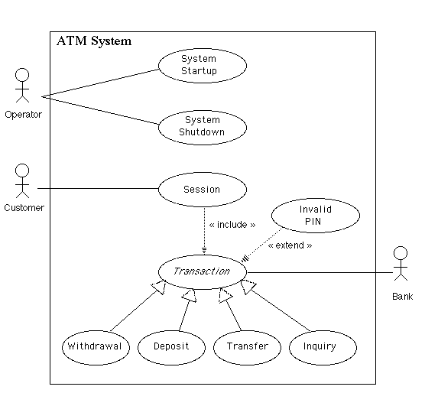
Use Case Diagram Example
http://www.math-cs.gordon.edu/local/courses/cs211/ATMExample/Intro.html

Slide 21
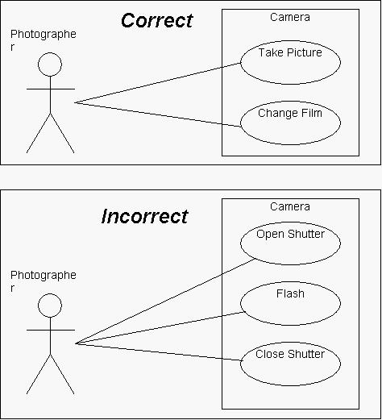
Use Case Diagram Example
http://www.andrew.cmu.edu/course/90-754/umlucdfaq.html

Slide 22
Summary of Steps for Functioal Requirements Modeling
Steps:
Initial idea
Repeat steps 3-5 until all functional requirements have been specified 3-5
3. Determine and define scenarios
4. Group scenarios in use cases
5. Factor, unify, simplify related use cases
6. Describe each use case as structured text (the use case description with its process steps). Include happy path, alternative paths, pathological paths
7. Complete a use case diagram for the use case (you may need additional use case diagrams for the alternative or pathological use case paths)
Use Case Model = Use Case Diagram + Use Case Description. We have one use case model for each functional requirement presented by the user
Functional Requirements Specification = Use Case Models (one for each use case) + Sequence Diagrams (one for each Use Case) + Communication Diagrams (one for each use case) + Supporting material
Requirements Specifications = Functional Requirements Specification + Non-functional Requirements Specification + Supporting material

Slide 23
Links to Supporting Material
https://www.tutorialspoint.com/uml/index.htm
http://agilemodeling.com/essays/umlDiagrams.htm
http://www.math-cs.gordon.edu/courses/cs211/ATMExample/

